Slide 1
Chat Bot Using Rasa
IN python
Presented By-Mayank
UID- 21MCA3230
Section-MCA-5B

Slide 2
What is a Chat Bot?
A chatbot is a conversational agent that interacts with users using natural language
Started as an attempt to fool humans.
Numerous applications of chatbots such as Customer Service, call centers etc.

Slide 3
Need for chatbots
Better Human Computer Interaction
Widespread use of personal machines
“To express their interest, wishes, or queries directly and naturally, by speaking, typing, and pointing”.

Slide 4
How does a chatbot looks like?
You: Hello
Bot: Hi. This is Railway Enquiry
You: What is the status of train 2803?
Bot: It’s right on time. The train will leave IST at 5:45 pm. Is there anything else I could assist you with?
You: No, thank you
Bot: You are welcome. Indian railways wishes a nice and happy journey.

Slide 5
How Do Chatbots Works?
Don’t have a good understanding of conversation
Are based on pattern matching
Chatterbots have a set of input and output rules
Recognize cue words from user and responds with a pre-calculated response
For e.g.:- Human: “I am feeling very worried today.”
Bot: “Why are you feeling worried lately?”
Other chatterbots learn through user interactions

Slide 6
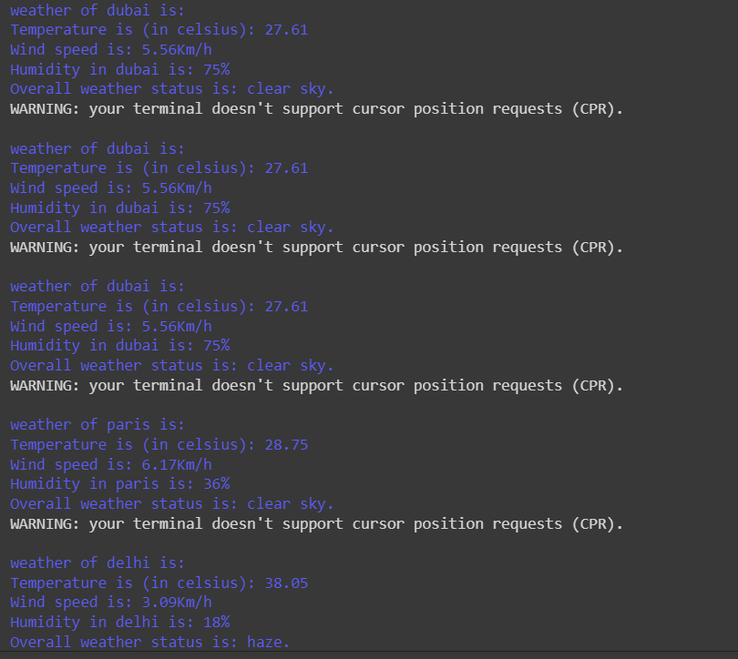
Weather Report of Different areas
Weather report is updated and shown By using Open Weather Map API

Slide 7
Want to see this BOT Working LIVE😎
Let's move to OUR COLLABORATORY THEN
JUST YOU have to click on this link
CLICK ME - CHAT BOT

Slide 8
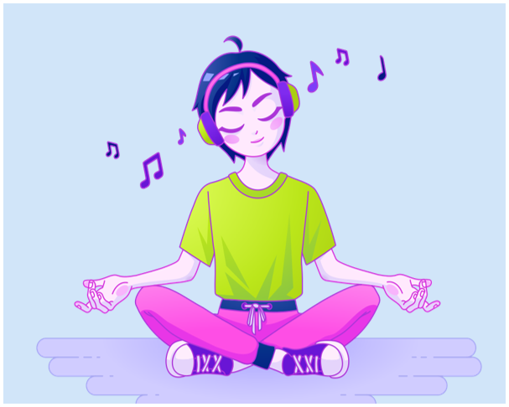
Any Questions ?
Thank you🎵

